Slide 1



Real-Time Data Streaming & Batch ETL Pipeline with AWS
University of New Haven- Tagliatela College of Engineering
DSCI-6007-02
Distributed & Scalable Data Engineering
Hybrid Architecture for Scalable Analytics

Slide 2





MEET OUR TEAM
Team 01 (Section 02)
STUTI BIMALI PRIYANKA SINGH LAKSHMAN RAJITH

Slide 3
Delayed Insights
Businesses struggle to analyze customer behavior in real time, leading to missed opportunities for personalized recommendations or fraud detection.
Poor Data Integration & Scalability
Many companies use separate data pipelines for real-time and batch processing, leading to fragmented analytics. Scaling such solutions across multiple teams is complex and costly.
Data Volume & Velocity
Many businesses lack a hybrid approach that processes both real-time and batch data efficiently. This leads to slow reporting, data redundancy, and high storage costs.
Inefficient ETL & Storage
Companies generate large volumes of real-time transactions, sensor data, or user logs, making traditional batch-based processing inefficient for time-sensitive analytics.
The Business Problems

Slide 4


Business Solutions
Real-Time Insights for Agile Teams Kinesis + Lambda enable instant data processing for live actions.
Automated, Cost-Efficient Batch Analytics Glue ETL pipelines auto-transform data into S3 for Athena queries.
Flexible Data Storage, Unified Access Hybrid MongoDB (operational) + S3 (analytics) bridges silos.
Secure by Design, Compliant by Default VPC with isolated subnets meets GDPR/HIPAA needs.
One Platform for All Analytics QuickSight unifies real-time dashboards + historical reports.
Future-Proof Scalability Serverless architecture scales seamlessly, cuts idle costs.

Slide 5
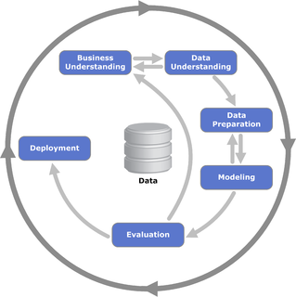
Crisp-DM Methodology

Slide 6
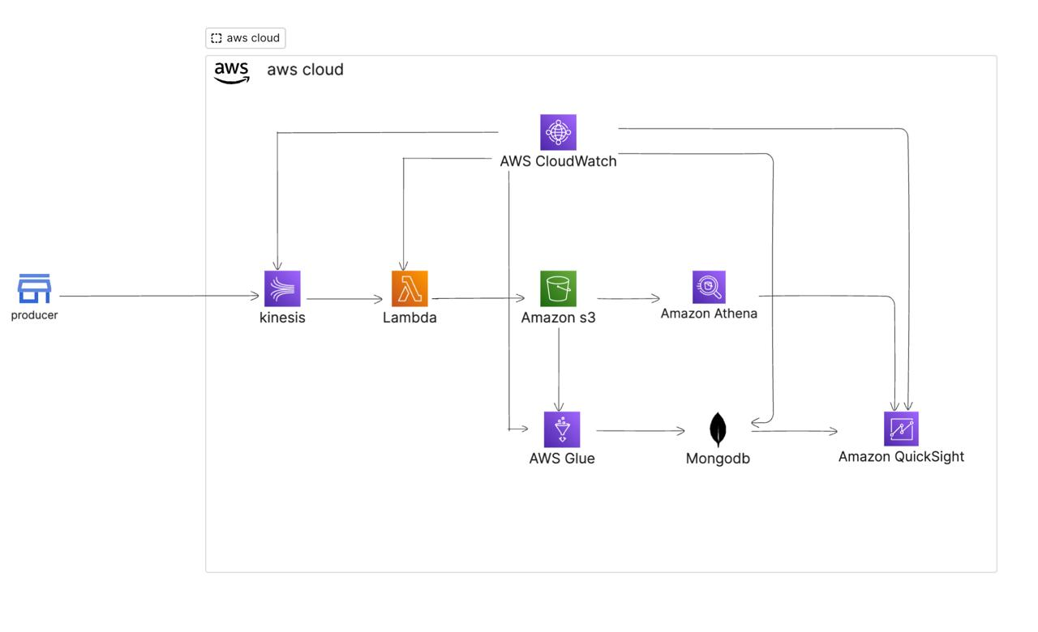
PLANNED PROJECT WORKFLOW

Slide 7

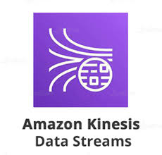

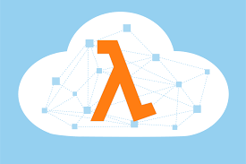

TOOLS AND TECHNOLOGIES
Amazon Athena
AWS S3
Amazon Kinesis
AWS Glue
AWS Lambda
Amazon Cloudwatch
MongoDB

Slide 8
BUSINESS IMPACT
Faster Decision-Making: React to trends in real time
Improved Customer Experience: Personalize offers dynamically
Operational Efficiency: Optimize inventory, fraud detection, and maintenance
Cost Savings: Reduce ETL & storage costs with a streamlined hybrid approach

Slide 9
CONCLUSION
The implementation of the Real-Time Data Streaming and Batch ETL Pipeline with AWS resulted in a scalable, efficient, and automated data processing system.
Enabled real-time data ingestion using AWS Kinesis for seamless streaming.
Processed and enriched data instantly with AWS Lambda.
Performed batch ETL transformations using AWS Glue, optimizing data for analytics.
Stored structured data efficiently in Amazon Redshift for fast querying.
Provided actionable insights through Amazon Athena and QuickSight dashboards.
Ensured reliability and automation with AWS CloudWatch monitoring.

